Slide 1

Smart Veterinary System
AI-Based Disease Detection
CSE 299 | Section 04 | Project Group 05
• Rishat Bin Sultan (2312559042)
• Fariha Islam (2311101642)
• Nafia Haque Muskan (2311677042)
• MD Tamim Hasan (2232239642)
Group 05 | Rishat Bin Sultan, Fariha Islam, Nafia Haque Muskan, MD Tamim Hasan

Slide 2
Project Overview
>> Objective
Build a Smart Veterinary System with AI-powered disease detection for pets
>> Completed
Account management, profile creation/editing, cart management, payment handling, order history
>> Tech Stack
Django (Backend), Frontend pages, Database operations
>> Status
Shop module & user account functionalities completed successfully
Group 05 | Rishat Bin Sultan, Fariha Islam, Nafia Haque Muskan, MD Tamim Hasan

Slide 3
Weekly Progress & Responsibilities
Completed Task | Responsible Member
Shop homepage & product display | Rishat Bin Sultan
Account pages & backend handling | Nafia Haque Muskan
Profile & edit profile pages | Nafia Haque Muskan
Add-to-cart functionality & Managed product, cart, and order-related database operations | Fariha Islam
Payment page & integration | MD Tamim Hasan
Order history & tracking | MD Tamim Hasan
Testing & debugging | All Members
Group 05 | Rishat Bin Sultan, Fariha Islam, Nafia Haque Muskan, MD Tamim Hasan

Slide 4
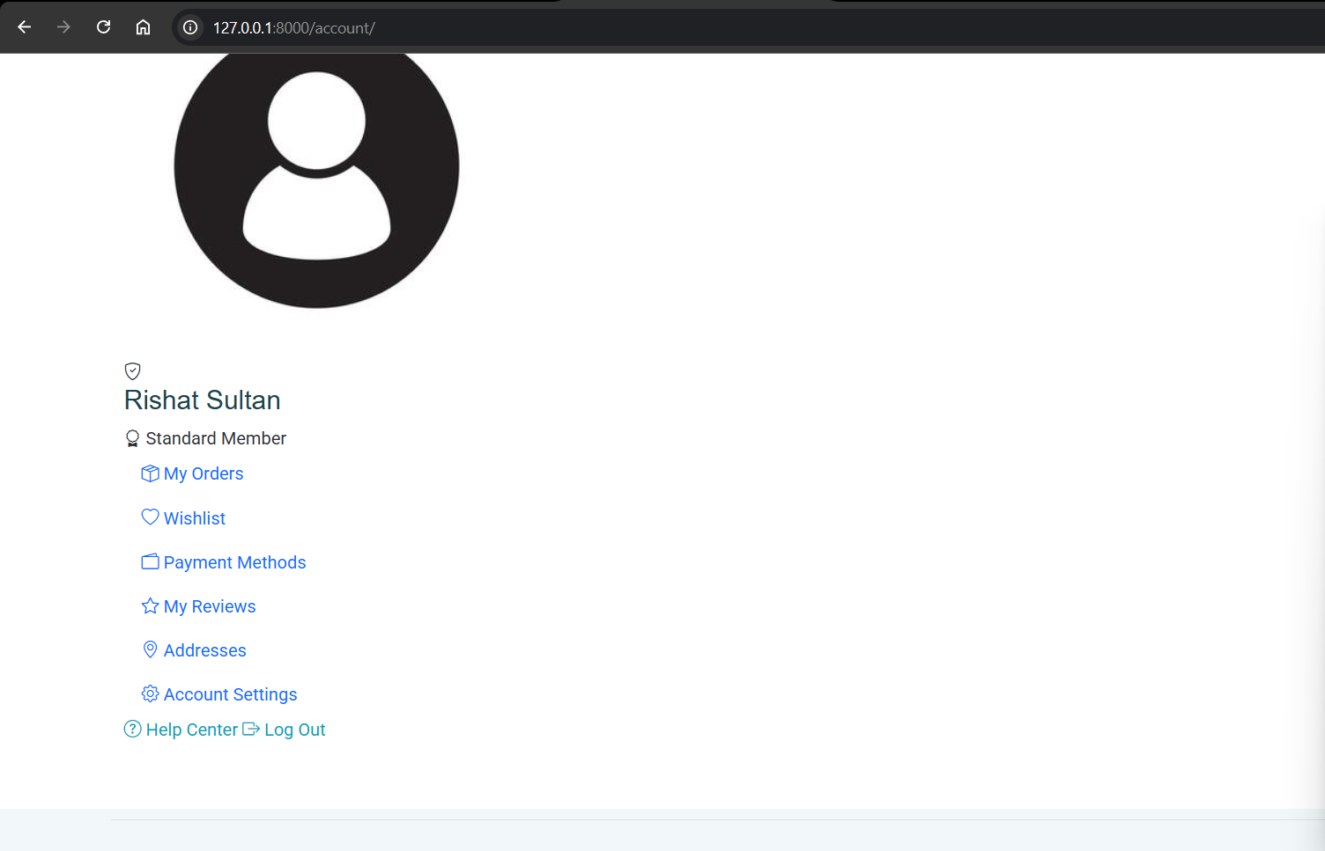
MY ACCOUNT
Group 05 | Rishat Bin Sultan, Fariha Islam, Nafia Haque Muskan, MD Tamim Hasan

Slide 5
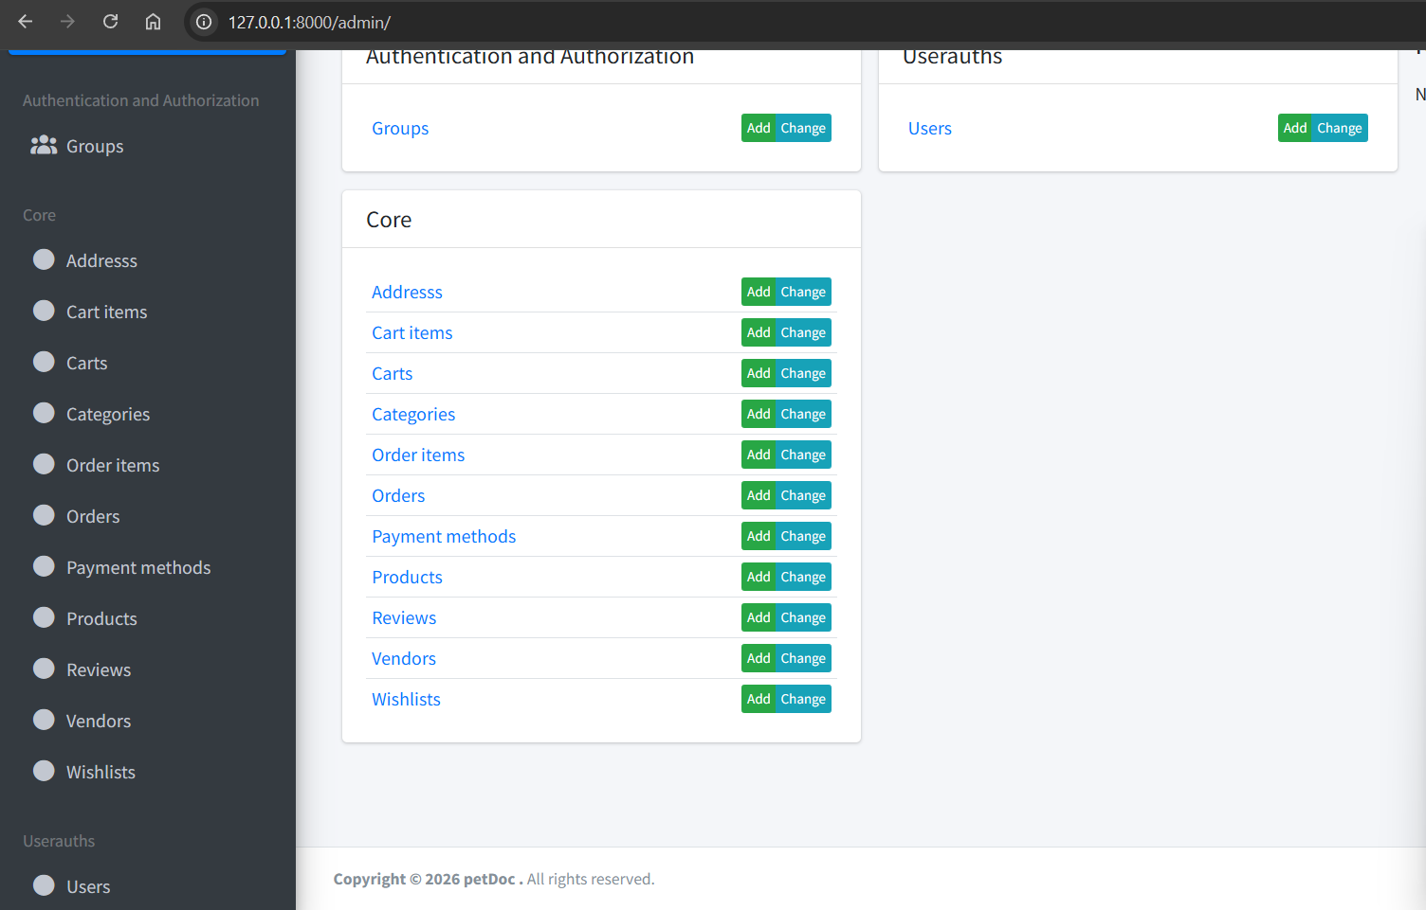
ADMIN DASHBOARD
Group 05 | Rishat Bin Sultan, Fariha Islam, Nafia Haque Muskan, MD Tamim Hasan

Slide 6
Challenges & Decisions
Challenges Faced
Key Decisions
• Coordinating frontend pages with backend functionality
• Cart updates & payment flow structure
• Order tracking organization
• User authentication for profile features
• Each member handles both frontend & backend for consistency
• Focus shifted to AI-based disease detection
• Frontend development nearly complete
Teamwork = Success!
Group 05 | Rishat Bin Sultan, Fariha Islam, Nafia Haque Muskan, MD Tamim Hasan

Slide 7
Future Plan: AI Disease Detection
1
Develop AI-based disease detection module
2
Prepare & preprocess pet disease datasets
3
Implement ML models using Python & Scikit-learn
4
Integrate AI model with Django backend
5
Test & evaluate prediction performance
Group 05 | Rishat Bin Sultan, Fariha Islam, Nafia Haque Muskan, MD Tamim Hasan

Slide 8
Conclusion
>> Accomplished
Shop system & user account functionalities successfully developed
>> Features Delivered
Account management, profile, cart, payment, order history
>> Development Approach
Frontend + Backend integration by each team member
>> Next Phase
AI-based disease detection using Python & Scikit-learn
Thank You!
Group 05 | Rishat Bin Sultan, Fariha Islam, Nafia Haque Muskan, MD Tamim Hasan

